Slide 1
Computer Organization and Assembly Language
By Abdual Qaddous

Slide 2
Data Size
Every computer has a word size, indicating the nominal size of pointer data.
A virtual address is encoded by such a word
The most important system parameter determined by the word size is the maximum size of the virtual address space.
That is, for a machine with a w-bit word size, the virtual addresses can range from 0 to 2w − 1, giving the program access to at most 2w bytes
A 32-bit word size limits the virtual address space to 4 gigabytes (written 4 GB).
Scaling up to a 64-bit word size leads to a virtual address space of 16 exabytes, or around 1.84 × 1019 bytes.
Most 64-bit machines can also run programs compiled for use on 32-bit machines, a form of backward compatibility

Slide 3
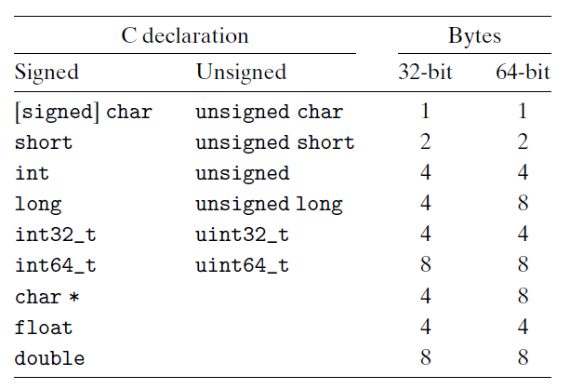
Cont..
Computers and compilers support multiple data formats using different ways to encode data, such as integers and floating point, as well as different lengths.

Slide 4
Addressing and Byte Ordering
For program objects that span multiple bytes, we must establish two conventions, what the address of the object will be, and how we will order the bytes in memory.
In virtually all machines, a multi-byte object is stored as a contiguous sequence of bytes.
For example, suppose a variable x of type int has address 0x100;
That is, the value of the address expression &x is 0x100.
Then (assuming data type int has a 32-bit representation) the 4 bytes of x would be stored in memory locations
0x100,
0x101,
0x102,
0x103.

Slide 5
Byte Representation
For ordering the bytes representing an object, there are two common conventions.
Some machines choose to store the object in memory ordered from least significant byte to most, while other machines store them from most to least.
The former convention—where the least significant byte comes first—is referred to as little endian.
The latter convention—where the most significant byte comes first—is referred to as big endian
Consider aw-bit integer having a bit representation [xw−1, xw−2, . . . , x1, x0],
where xw−1 is the most significant bit and x0 is the least.

Slide 6
Practice
Suppose the variable x of type int and at address 0x100 has a hexadecimal value of 0x01234567.
The ordering of the bytes within the address range 0x100 through 0x103 depends on the type of machine:
Express this value into little and big endian

Slide 7
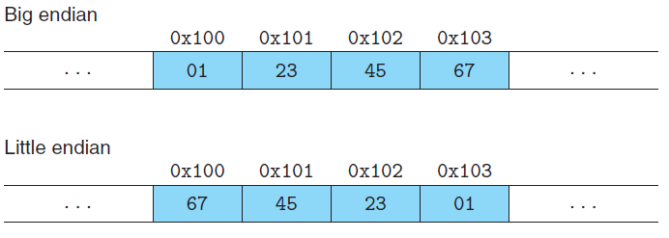
Solution

Slide 8
Implementation of little and big endian
Most Intel-compatible machines operate exclusively in little-endian mode. On the other hand, most machines from IBM and Oracle operate in big-endian mode.
Many recent microprocessor chips are bi-endian, meaning that they can be configured to operate as either little- or big-endian machines.
In practice, however, byte ordering becomes fixed once a particular operating system is chosen. For example, ARM microprocessors, used in many cell phones, have hardware that can operate in either little- or big-endian mode,
But the two most common operating systems for these chips—Android (from Google) and IOS (from Apple)—operate only in little-endian mode.
For most application programmers, the byte orderings used by their machines are totally invisible; programs compiled for either class of machine give identical results.

Slide 9
Bi-endian Problem on Network
when binary data are communicated over a network between different machines. A common problem is for data produced by a little-endian machine to be sent to a big-endian machine, or vice versa, leading to the bytes within the words being in reverse order for the receiving program.

Slide 10
Solution
To avoid such problems, code written for networking applications must follow established conventions for byte ordering
To make sure the sending machine converts its internal representation to the network standard
while the receiving machine converts the network standard to its internal representation.

Slide 11
Representation of code
Consider the following C function:
int sum(int x, int y)
{
return x + y;
}
When compiled on our sample machines, we generate machine code having the following byte representations:
Linux 32 55 89 e5 8b 45 0c 03 45 08 c9 c3
Windows 55 89 e5 8b 45 0c 03 45 08 5d c3
Sun 81 c3 e0 08 90 02 00 09
Linux 64 55 48 89 e5 89 7d fc 89 75 f8 03 45 fc c9 c3

Slide 12
Cont…
Here we find that the instruction coding are different.
Different machine types use different and incompatible instructions and encodings.
Even identical processors running different operating systems have differences in their coding conventions and hence are not binary compatible.
Binary code is seldom portable across different combinations of machine and operating system.

Slide 13
Introduction to Boolean Algebra
Since binary values are at the core of how computers encode, store, and manipulate information, a rich body of mathematical knowledge has evolved around the study of the values 0 and 1.
This started with the work of George Boole (1815–1864) around 1850 and thus is known as Boolean algebra.
Boole observed that by encoding logic values true and false as binary values 1 and 0, he could formulate an algebra that captures the basic principles of logical reasoning.
The simplest Boolean algebra is defined over the two-element set {0, 1}.

Slide 14
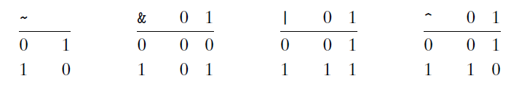
Operation of Boolean Algebra
Binary values 1 and 0 encode logic values true and false, while operations ~, &, |, and ^ encode logical operations not, and, or, and exclusive-or, respectively.

Slide 15
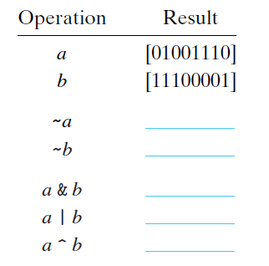
Practice
Fill in the following table showing the results of evaluating Boolean operations on bit vectors.

Slide 16
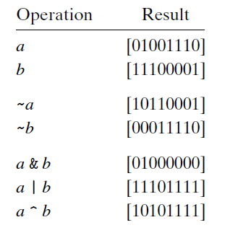
Solution

Slide 17
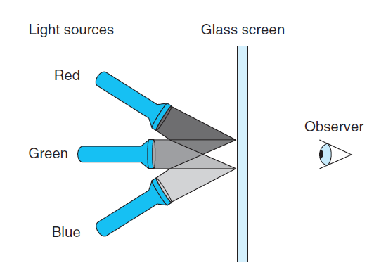
Example
Computers generate color pictures on a video screen or liquid crystal display by mixing three different colors of light: red, green, and blue.
Imagine a simple scheme, with three different lights, each of which can be turned on or off, projecting onto a glass screen:

Slide 18
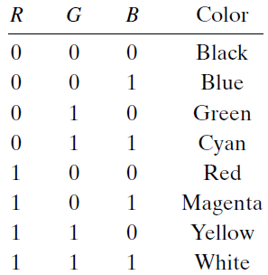
Cont..
We can then create eight different colors based on the absence (0) or presence
(1) of light sources R, G, and B

Slide 19
Think
Describe the effect of applying Boolean operations on the following colors:
Blue | Green =
Yellow & Cyan =
Red ^ Magenta =
How we compute complement of these colure?

Slide 20
Solution
Blue | Green =cyan
001|010=011
Yellow & Cyan = Green
110&011=010
Red ^ Magenta = Blue
100+101=001
2.The complement of a color is formed by turning off the lights that are on and turning on the lights that are off.

Slide 21
Swapping the value
As an application of the property that a ^ a = 0 for any bit vector a, consider the following program:
1 void inplace_swap(int *x, int *y) {
2 *y = *x ^ *y; /* Step 1 */
3 *x = *x ^ *y; /* Step 2 */
4 *y = *x ^ *y; /* Step 3 */
5 }

Slide 22
Practice
Starting with values a and b in the locations pointed to by x and y, respectively, fill in the table that follows, giving the values stored at the two locations after each step of the procedure. Use the properties of ^ to show that the desired effect is achieved.
Recall that every element is its own additive inverse (that is, a ^ a = 0).
Step *x *y
Initially a b
Step 1________ __________
Step 2________ __________
Step 3________ __________

Slide 23
Solution
This procedure relies on the fact that exclusive-or is commutative and associative,
and that a ^ a = 0 for any a.
Step *x *y
Initially a b
Step 1 a a^ b
Step 2 a ^ (a ^ b) = (a ^ a) ^ b =b a^ b
Step 3 b b^ (a ^ b) = (b ^ b) ^ a = a

Slide 24
Think
When you apply your function to an array containing elements 1, 2, 3, and 4, you find the array now has, as expected, elements 4, 3, 2, and 1.
When you try it on an array with elements 1, 2, 3, 4, and 5, however, you are surprised to see that the array now has elements 5, 4, 0, 2, and 1.
In fact, you discover that the code always works correctly on arrays of even length, but it sets the middle element to 0 whenever the array has odd length.
Why???

Slide 25
Problem
void reverse_array(int a[], int cnt)
{
int first, last;
for (first = 0, last = cnt-1;
first <= last;
first++,last--)
inplace_swap(&a[first], &a[last]);
}
For an array of odd length cnt= 2k + 1, what are the values of variables first and last in the final iteration of function reverse_array?
B. Why does this call to function inplace_swap set the array element to 0?
C. What simple modification to the code for reverse_array would eliminate this problem?

Slide 26
Solution
Both first and last have value k, so we are attempting to swap the middle element with itself.
B. In this case, arguments x and y to inplace_swap both point to the same location. When we compute *x ^ *y, we get 0.We then store 0 as the middle element of the array, and the subsequent steps keep setting this element to 0.
C. Simply replace the test in line 4 of reverse_array to be first < last, since there is no need to swap the middle element with itself.

Slide 27
Masking
One common use of bit-level operations is to implement masking operations,
where a mask is a bit pattern that indicates a selected set of bits within a word.
As an example, the mask 0xFF (having ones for the least significant 8 bits) indicates the low-order byte of a word.
The bit-level operation x & 0xFF yields a value consisting of the least significant byte of x, but with all other bytes set to 0.
For example, with x = 0x89ABCDEF, the expression would yield 0x000000EF.
The expression ~0 will yield a mask of all ones, regardless of the size of the data representation. The same mask can be written 0xFFFFFFFF when data type int is 32 bits, but it would not be as portable.

Slide 28
Practice
Write C expressions, in terms of variable x, for the following values. Your code should work for any word size w ≥ 8. For reference, we show the result of evaluating the expressions for x = 0x87654321, with w = 32.
The least significant byte of x, with all other bits set to 0. [0x00000021]
B. All but the least significant byte of x complemented, with the least significant byte left unchanged. [0x789ABC21]
C. The least significant byte set to all ones, and all other bytes of x left unchanged. [0x876543FF]

Slide 29
Solution
A. x & 0xFF
B. x ^ ~0xFF
C. x | 0xFF

